Slide 1


SAP S/4HANA Training
MASTER DATA GOVERNANCE (SAP MDG)
Neeraj Gupta
Session 23
SAP MDG – Data Enrichment Framework

Slide 2
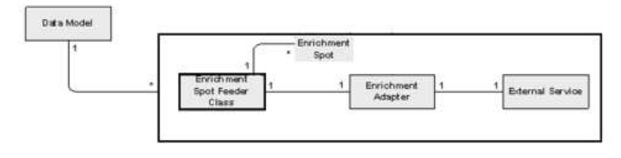
Enrichment Framework (CA-MDG-DQ-ENR)
23
SAP MDG – Data Enrichment
Purpose: To enrich the MDG data with external services or with internal logic
Terms:
Enrichment Spot - Address Enrichment spot
Enrichment Adapter - Implementation of interface IF_USMD_ENRICHMENT_ADAPTER
Enrichment Feeder - A feeder is mainly used to convert data (for structure mapping and for data mapping)
Enrichment UI – Web Dynpro UI implements interface MDG_ENRICHMENT_INTF

Slide 3
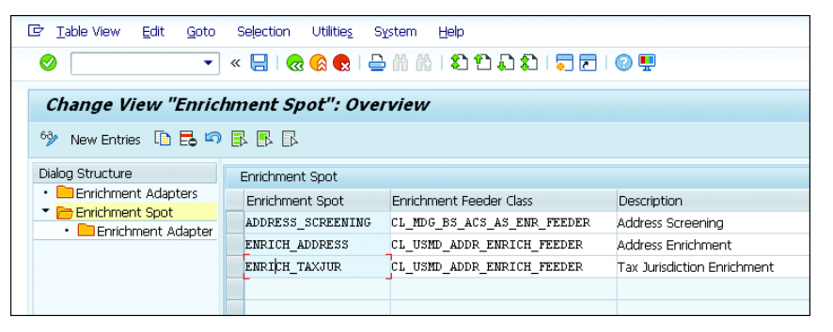
Enrichment Spots
23
SAP MDG – Data Enrichment

Slide 4
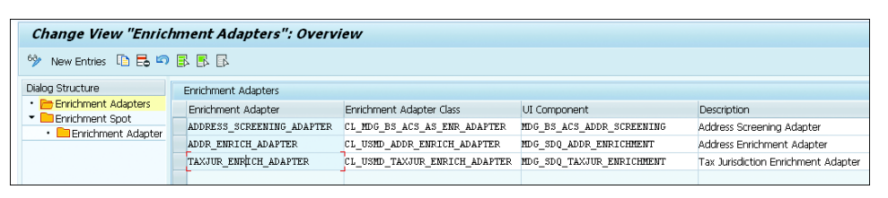
Enrichment Adapter
23
SAP MDG – Data Enrichment
Call to the external/internal service
Example:
Address enrichment adapter call made to SAP Data Services
>> Sends the address entered by the SAP Master Data Governance requester on the UI
>> Gets the address data enriched

Slide 5
Enrichment Adapter
23
SAP MDG – Data Enrichment
Interface: IF_USMD_ENRICHMENT_ADAPTER
Method:IF_USMD_ENRICHMENT_ADAPTER~EXECUTE
Parameters:
C_LAST_USER_ACTION Action Code
ET_MESSAGE Messages
EF_USER_ACTION_NECESSARY Indicator to specify whether an user interaction is necessary or not
ER_DATA Data that is needed for displaying the UI if user interaction is necessary
ET_ADDITIONAL_DATA Name value pair to hold any additional data necessary for UI interaction
CS_DATA Data to be enriched

Slide 6
Enrichment Feeder
23
SAP MDG – Data Enrichment
Interface: IF_USMD_ENRICHMENT_FEEDER
Method:IF_USMD_ENRICHMENT_FEEDER~GET_RELEVANT_ENTITIES
Parameters:
ET_READ_ENTITIES Exporting Type USMD_T_ENTITY Entities that have to be read
E_WRITE_ENTITY Exporting Type USMD_ENTITY Entity that would be enriched
ET_ATTRIBUTE Exporting Type USMD_TS_FIELDNAME Attributes of the entity
that has to be enriched
ET_ATTR_NO_MAP Exporting Type USMD_TS_FIELDNAME Attributes of write entity
not mapped for enrichment

Slide 7
Use Case: DUNS Enrichment
23
SAP MDG – Data Enrichment
>> Reads AD_POSTAL, BP_CENTRL and BP_ADDUSG as input data
>> Attributes of BP_IDNUM are being updated / must be editable: BP_ID_TYPE and BP_ID_NUM
>> Method: IF_USMD_ENRICHMENT_FEEDER~GET_ADAPTER_DATA
In adapter format
>> Parameters:
IO_APP_CONTEXT - Application context contains the CR type, CR ID, Business Activity
IO_MODEL - Reference to the model extension interface that enables necessary data to
be read from MDG
IT_KEY_ALL - All the keys and the data involved in the current CR (For example, in the case of supplier, the entities are CR, BP_HEADER and ADDRNO.)
ER_DATA - Data in adapter format

Slide 8
Use Case: DUNS Enrichment
23
SAP MDG – Data Enrichment
>> Reads AD_POSTAL, BP_CENTRL and BP_ADDUSG as input data
>> Attributes of BP_IDNUM are being updated / must be editable: BP_ID_TYPE and BP_ID_NUM
>> Method: IF_USMD_ENRICHMENT_FEEDER~GET_MDG_DATA
Coverts from adapter format to MDG Format
>> Parameters:
IT_DATA – Table, structure contains the following components
WRITE_DATA contains the enriched data in adapter format
• ATTRIBUTE_LIST contains the list of attributes that have changed after the enrichment. The attribute list contains the fields from the adapter structure.
IO_DATA_WRITE - Buffer instance that can be used to write data into MDG using it’s
WRITE_DATA method
ER_DATA - Data in MDG format

Slide 9
Use Case: DUNS Enrichment
23
SAP MDG – Data Enrichment
>> Reads AD_POSTAL, BP_CENTRL and BP_ADDUSG as input data
>> Attributes of BP_IDNUM are being updated / must be editable: BP_ID_TYPE and BP_ID_NUM
>> Method: IF_USMD_ENRICHMENT_FEEDER~PREPARE_UI_DATA
Provides data for UI, Coverts from adapter format to MDG Format
>> Parameters:
IV_VIEW_TYPE – View Type (hardcoded as SCR1) >> Initial screen
IR_DATA - Data necessary for UI interaction returned by the adapter in adapter format
ER_DATA - Data in MDG format for UI >> sent to WDA UI using the SHOW_ENRICHEMENT_UI method

Slide 10
Use Case: DUNS Enrichment
23
SAP MDG – Data Enrichment
>> Reads AD_POSTAL, BP_CENTRL and BP_ADDUSG as input data
>> Attributes of BP_IDNUM are being updated / must be editable: BP_ID_TYPE and BP_ID_NUM
>> Method: IF_USMD_ENRICHMENT_FEEDER~IS_RELEVANT
Checks if enrichment is valid for current OTC / CR
>> Parameters:
IV_OTC – Business Object Type
EV_RELEVANT- Whether this enrichment is relevant for a BO Type or not

Slide 11
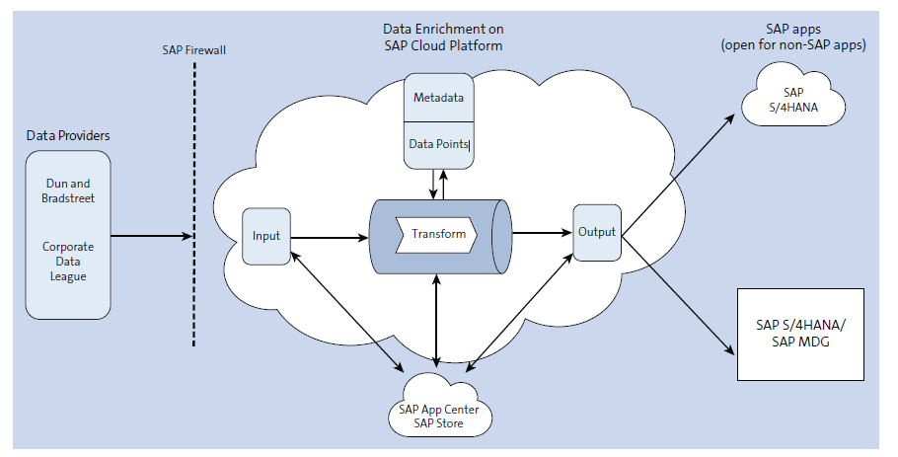
SAP S/4HANA cloud for data enrichment integration for external data
23
SAP MDG – Data Enrichment

Slide 12
Configuring address screening in SAP MDG central governance
23
SAP MDG – Data Enrichment

Slide 13
Sequence Diagram (Interaction between enrichment components)
23
SAP MDG – Data Enrichment

Slide 14
Data enrichment framework in SAP MDG
23
SAP MDG – Data Enrichment

Slide 15
Data enrichment Customizing
23
SAP MDG – Data Enrichment
Define Enrichment Spots
Enrichment Spot folder, create a new entry, and enter necessary details such as Enrichment Spot name, the Enrichment Feeder Class and a Description

Slide 16
Data enrichment Customizing
23
SAP MDG – Data Enrichment
Define Enrichment Adapter
Enter the necessary details such as Enrichment Adapter name, Enrichment Adapter Class, the WebDynpro UI component for the enrichment, and a description for the adapter

Slide 17
Data enrichment Customizing
23
SAP MDG – Data Enrichment
Define Enrichment Adapter
Select the adapter for the enrichment from the search help

Slide 18
Data enrichment Customizing
23
SAP MDG – Data Enrichment
Ensure Enrichment Occurs at Specific Change Request Steps >> Go to Enhancements and Checks per Change Request Step and mark the enrichment as relevant

Slide 19
Maintaining RFC destination FL_GDQC_SERVER for SAP DQM integration
23
SAP MDG – Data Enrichment

Slide 20
Maintaining RFC destination FL_GDQC_BATCH for SAP DQM integration
23
SAP MDG – Data Enrichment

Slide 21
Address enrichment and duplicate check configuration for change request step
23
SAP MDG – Data Enrichment

Slide 22

End of Session23

Slide 23

Questions

Slide 24

Neeraj gupta

Slide 25


We’re committed to empower you to be
Most Desirable Resource
through powerful training solutions.
We build the workforce of the future.
250+
Corporate Clients
30,000+
Learners Trained
25000+
Learners Placed
FREE WEBINARS
Sign up for free webinars with industry experts every fortnight!
Enroll Now!
Contact us today!
https://anubhavtrainings.com/

Slide 26




More from AnubhavTrainings.com

